Slide 1
GRADE 7 ACCELERATED · UNIT 5 · LESSON 4
Real-World Scale Drawings
MA.7.GR.1.5
I can use a scale such as ¼ in : 1 ft to find real lengths and areas from a drawing, and drawing lengths from real ones.
Grade 7 Accelerated · Unit 5 · Lesson 4 — Real-World Scale Drawings
1

Slide 2

Warm-Up
1. A figure with area 9 cm² is scaled by k = 2. Find the copy's area.
2. A 5 cm side becomes 3 cm in the copy. Find the scale factor.
3. Find the product:
4. A car goes 90 miles in 2 hours. How far does it go per hour?
Grade 7 Accelerated · Unit 5 · Lesson 4 — Real-World Scale Drawings
2

Slide 3
Warm-Up
1. A figure with area 9 cm² is scaled by k = 2. Find the copy's area.
36 cm²
2. A 5 cm side becomes 3 cm in the copy. Find the scale factor.
k = 0.6
3. Find the product:
3.6
4. A car goes 90 miles in 2 hours. How far does it go per hour?
45 miles per hour
Grade 7 Accelerated · Unit 5 · Lesson 4 — Real-World Scale Drawings
3

Slide 4
Vocabulary
floor plan
a scale drawing of a room or building seen from above
scale (two units)
a ratio such as ¼ in : 1 ft — a drawing length and the real length it stands for
unit rate of a scale
the scale written per 1 drawing unit: ¼ in : 1 ft is 1 in : 4 ft
Grade 7 Accelerated · Unit 5 · Lesson 4 — Real-World Scale Drawings
4

Slide 5

Notes
I. A scale is a rate: write it per 1 unit
Drawing × rate = real. Real ÷ rate = drawing.
Grade 7 Accelerated · Unit 5 · Lesson 4 — Real-World Scale Drawings
5

Slide 6
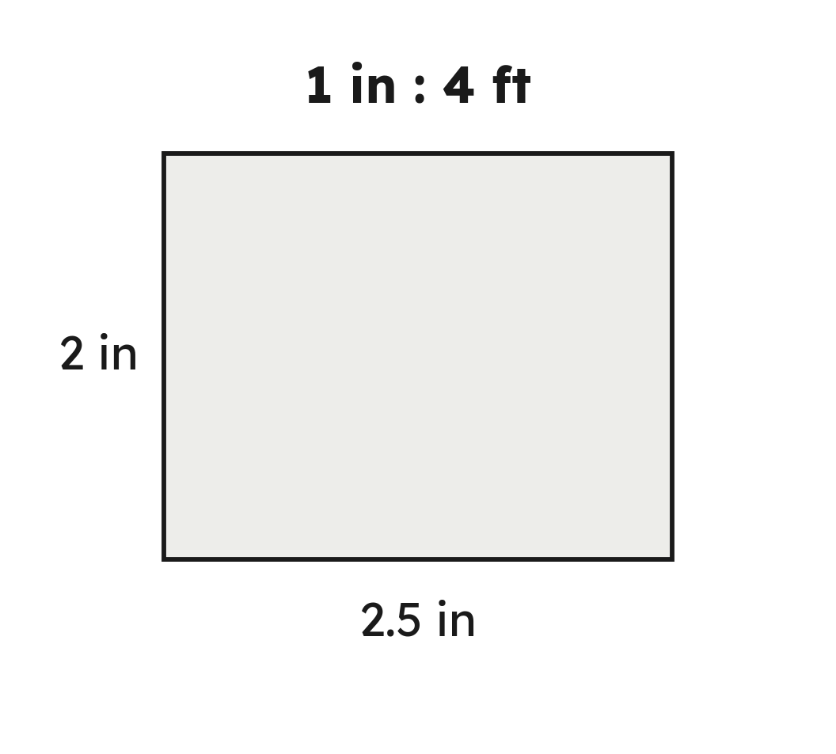

Notes
II. Area: go to the real dimensions first
Grade 7 Accelerated · Unit 5 · Lesson 4 — Real-World Scale Drawings
6

Slide 7

Notes
III. Real to drawing is a division
Grade 7 Accelerated · Unit 5 · Lesson 4 — Real-World Scale Drawings
7

Slide 8
Example 1
A floor plan is drawn at ¼ in : 1 ft. A room is 2.5 in by 3 in on the plan.
Find the room's real dimensions and area.
Grade 7 Accelerated · Unit 5 · Lesson 4 — Real-World Scale Drawings
8

Slide 9


Example 1
Answer: 10 ft by 12 ft; 120 ft²
Grade 7 Accelerated · Unit 5 · Lesson 4 — Real-World Scale Drawings
9

Slide 10
Your Turn
A floor plan is drawn at ¼ in : 1 ft. A room is 1.5 in by 4 in on the plan.
Find the room's real dimensions and area.
Grade 7 Accelerated · Unit 5 · Lesson 4 — Real-World Scale Drawings
10

Slide 11

Your Turn
A floor plan is drawn at ¼ in : 1 ft. A room is 1.5 in by 4 in on the plan.
Find the room's real dimensions and area.
Answer: 6 ft by 16 ft; 96 ft²
Grade 7 Accelerated · Unit 5 · Lesson 4 — Real-World Scale Drawings
11

Slide 12
Example 2
A map is drawn at 1 cm : 50 km. Two towns are 7.4 cm apart on it. A bus travels at 100 km per hour.
How far apart are the towns, and how long does the bus take?
Grade 7 Accelerated · Unit 5 · Lesson 4 — Real-World Scale Drawings
12

Slide 13


Example 2
Answer: 370 km; 3.7 hours
Grade 7 Accelerated · Unit 5 · Lesson 4 — Real-World Scale Drawings
13

Slide 14
Your Turn
A map is drawn at 1 cm : 25 km. Two towns are 6.2 cm apart on it. A bus travels at 50 km per hour.
How far apart are the towns, and how long does the bus take?
Grade 7 Accelerated · Unit 5 · Lesson 4 — Real-World Scale Drawings
14

Slide 15


Your Turn
A map is drawn at 1 cm : 25 km. Two towns are 6.2 cm apart on it. A bus travels at 50 km per hour.
How far apart are the towns, and how long does the bus take?
Answer: 155 km; 3.1 hours
Grade 7 Accelerated · Unit 5 · Lesson 4 — Real-World Scale Drawings
15

Slide 16
Whiteboards · Question 1 of 9
A plan is drawn at ½ in : 1 ft. A wall is 4 in long on it.
How long is the real wall?
Answer it.
Grade 7 Accelerated · Unit 5 · Lesson 4 — Real-World Scale Drawings
16

Slide 17


Whiteboards · Question 1 of 9
A plan is drawn at ½ in : 1 ft. A wall is 4 in long on it.
How long is the real wall?
Answer: 8 ft
Grade 7 Accelerated · Unit 5 · Lesson 4 — Real-World Scale Drawings
17

Slide 18
Whiteboards · Question 2 of 9
A plan is drawn at 1 in : 3 ft. A room is 2.5 in long on it.
How long is the real room?
Answer it.
Grade 7 Accelerated · Unit 5 · Lesson 4 — Real-World Scale Drawings
18

Slide 19

Whiteboards · Question 2 of 9
A plan is drawn at 1 in : 3 ft. A room is 2.5 in long on it.
How long is the real room?
Answer: 7.5 ft
Grade 7 Accelerated · Unit 5 · Lesson 4 — Real-World Scale Drawings
19

Slide 20
Whiteboards · Question 3 of 9
A plan is drawn at 1 in : 3 ft. A real wall is 21 ft long.
How long is it on the plan?
Answer it.
Grade 7 Accelerated · Unit 5 · Lesson 4 — Real-World Scale Drawings
20

Slide 21

Whiteboards · Question 3 of 9
A plan is drawn at 1 in : 3 ft. A real wall is 21 ft long.
How long is it on the plan?
Answer: 7 in
Grade 7 Accelerated · Unit 5 · Lesson 4 — Real-World Scale Drawings
21

Slide 22




Whiteboards · Question 4 of 9
A model car is built at 1 : 50 and is 8 cm long.
How long is the real car?
A.
B.
C.
D.
Answer it.
Grade 7 Accelerated · Unit 5 · Lesson 4 — Real-World Scale Drawings
22

Slide 23


Whiteboards · Question 4 of 9
A model car is built at 1 : 50 and is 8 cm long.
How long is the real car?
cm
m
Answer: A — 4 m
Grade 7 Accelerated · Unit 5 · Lesson 4 — Real-World Scale Drawings
23

Slide 24
Whiteboards · Question 5 of 9
A plan is drawn at ¼ in : 1 ft. A real wall is 15 ft long.
How long is it on the plan?
Answer it.
Grade 7 Accelerated · Unit 5 · Lesson 4 — Real-World Scale Drawings
24

Slide 25
Whiteboards · Question 5 of 9
A plan is drawn at ¼ in : 1 ft. A real wall is 15 ft long.
How long is it on the plan?
Answer: 3.75 in
Grade 7 Accelerated · Unit 5 · Lesson 4 — Real-World Scale Drawings
25

Slide 26




Whiteboards · Question 6 of 9
A plan is drawn at 1 in : 4 ft. A room is 2 in by 3 in on it.
What is the room's real area?
A.
B.
C.
D.
Answer it.
Grade 7 Accelerated · Unit 5 · Lesson 4 — Real-World Scale Drawings
26

Slide 27

Whiteboards · Question 6 of 9
A plan is drawn at 1 in : 4 ft. A room is 2 in by 3 in on it.
What is the room's real area?
Answer: B — 96 ft²
Grade 7 Accelerated · Unit 5 · Lesson 4 — Real-World Scale Drawings
27

Slide 28
Whiteboards · Question 7 of 9
A plane is 48 ft long. One model of it is built at 1 : 48, another at 1 : 72.
Which model is longer, and by how much?
Answer it.
Grade 7 Accelerated · Unit 5 · Lesson 4 — Real-World Scale Drawings
28

Slide 29

Whiteboards · Question 7 of 9
A plane is 48 ft long. One model of it is built at 1 : 48, another at 1 : 72.
Which model is longer, and by how much?
in
Answer: The 1 : 48 model, by 4 in (12 in against 8 in)
Grade 7 Accelerated · Unit 5 · Lesson 4 — Real-World Scale Drawings
29

Slide 30
Whiteboards · Question 8 of 9
Mia, who is 12, enlarges her 9 in by 12 in poster into a mural at 1 in : 2 ft.
What are the mural's dimensions?
Answer it.
Grade 7 Accelerated · Unit 5 · Lesson 4 — Real-World Scale Drawings
30

Slide 31
Whiteboards · Question 8 of 9
Mia, who is 12, enlarges her 9 in by 12 in poster into a mural at 1 in : 2 ft.
What are the mural's dimensions?
Answer: 18 ft by 24 ft
Grade 7 Accelerated · Unit 5 · Lesson 4 — Real-World Scale Drawings
31

Slide 32
Whiteboards · Question 9 of 9
Andrew's drawing shows a wall 3.5 in wide; the real wall is 26.25 ft wide. The drawn height is 4 in.
Find the real height and the wall's real area. Which step uses the scale factor?
Write your answer in sentences.
Grade 7 Accelerated · Unit 5 · Lesson 4 — Real-World Scale Drawings
32

Slide 33
Whiteboards · Question 9 of 9
Andrew's drawing shows a wall 3.5 in wide; the real wall is 26.25 ft wide. The drawn height is 4 in.
Find the real height and the wall's real area. Which step uses the scale factor?
Answer: 30 ft high; 787.5 ft². The scale factor (7.5 ft per in) is the step from 4 in to 30 ft.
Grade 7 Accelerated · Unit 5 · Lesson 4 — Real-World Scale Drawings
33

Slide 34
Independent Set
1.
A plan is drawn at ½ in : 1 ft. A wall is 6 in long on it. Find the real length.
2.
A plan is drawn at 1 in : 5 ft. A room is 3.2 in long on it. Find the real length.
3.
A plan is drawn at 1 in : 5 ft. A real wall is 22 ft long. Find its length on the plan.
4.
A plan is drawn at ¼ in : 1 ft. A room is 2 in by 3.5 in on it. Find the real dimensions and area.
5.
A model boat is built at 1 : 40 and is 15 cm long. Find the real boat's length in metres.
6.
A map is drawn at 1 cm : 20 km. Two towns are 8.5 cm apart on it. How far apart are they, and how long does a train at 85 km per hour take?
Grade 7 Accelerated · Unit 5 · Lesson 4 — Real-World Scale Drawings
34

Slide 35
IXL
1.
Open IXL and start today's skills.
2.
Work on paper where the question needs work. The answer box does not show it.
3.
Every skill listed is required, to a SmartScore of 67. Due at the start of the next class.
Today's skills — all required
Scale drawings: word problems — 84H
Scale drawings: scale factor word problems — KCM
Grade 7 Accelerated · Unit 5 · Lesson 4 — Real-World Scale Drawings
35

